Slide 1
Team invincible size and fit nit rourkela
Arpita Mohapatra: ampops169@gmail.com
Aparajita Panigrahi: panigrahi.aparajita@gmail.com
Sayna Parida: saynaparida33@gmail.com

Slide 2
Problem statement
While ecommerce has an access to global markets fulfilling costumers’ fashion needs worldwide, there can be lack of security, reliability leading to increasing returns, reverse pickup cost, etc leading to huge loss.
Customers steer clear of online shopping because it do not give them an option to try-on the clothes as in traditional mode of shopping.
The biggest problem lies in picking the right size and fit when there is such inconsistency in sizing among various brands.
Wrong size and fit is the top reason for returning of merchandise bought online leading to increased added cost, clash of fashion and tech.

Slide 3

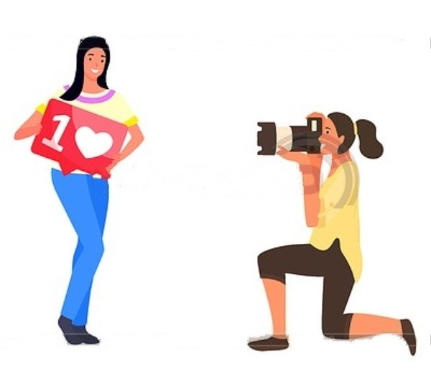
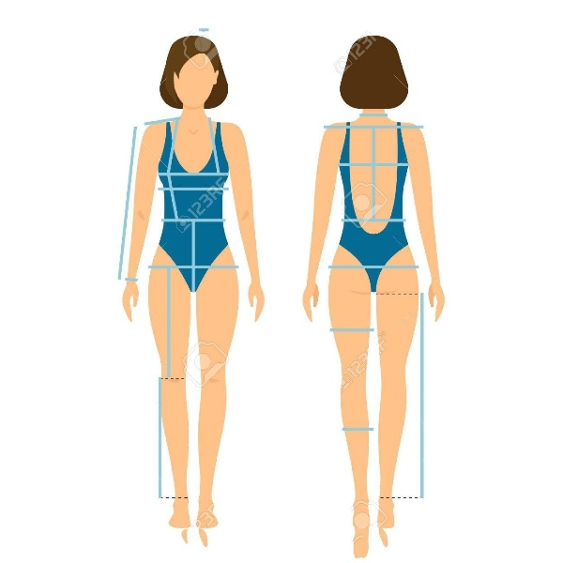
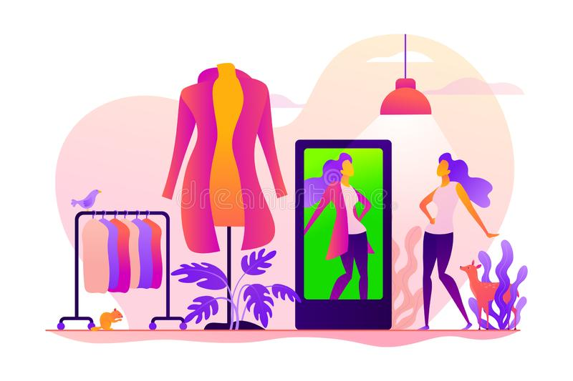
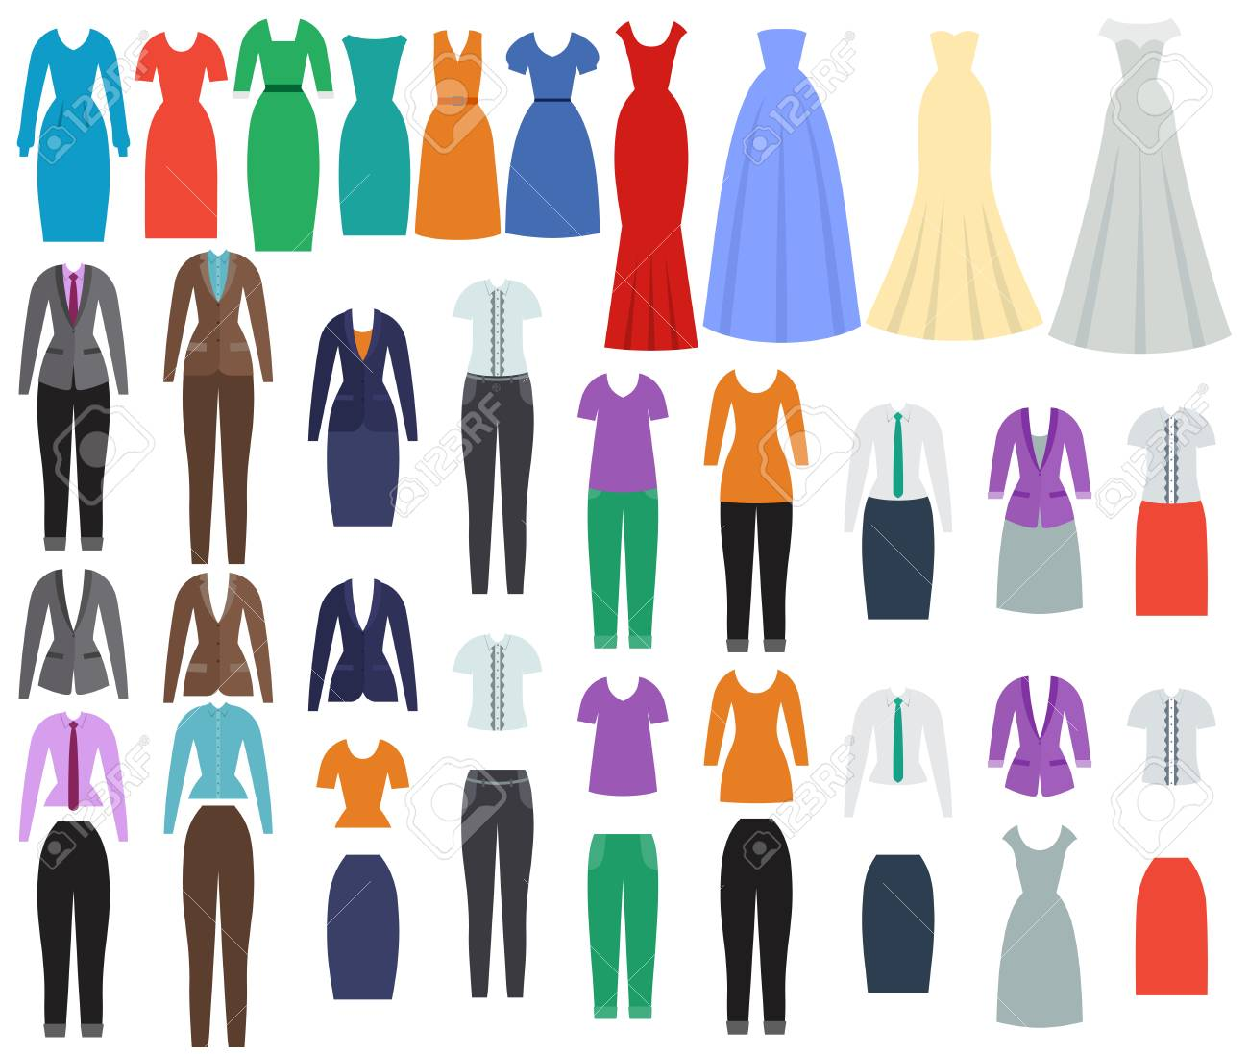
proposed solution
Processing on user image for setting proper alignment and syncing with user’s personal data
Taking a picture using webcam or any other device
Scanning user’s body for taking accurate measurements
Final result with added background
Choosing garment image to try on

Slide 4
Solution deep-dive
1
2
Interactive GUI
Web/app based user interactive platform.
Pose Estimation
Pose estimation of the user image using deep neural networks.
Based on body measurements size of cloth is recommended.
Virtual try-on
Virtual try-on of selected clothes from cloud database along with background.
User feeds his/her data through a secured interface.
The image is further parsed.
Based on skin tone of user, suitable cloth is recommended.
Recommendation
4
3

Slide 5
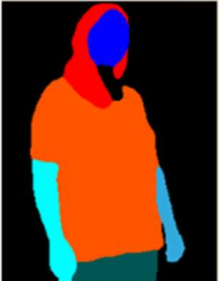
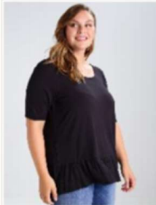
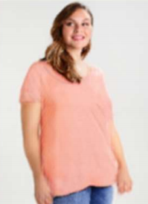
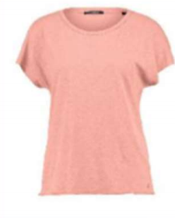
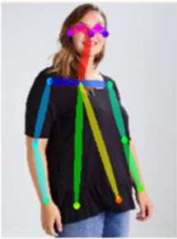
Parsing of input image
Garment to be tried on
Input photo of user
Output image
Pose estimation of input image

Slide 6


impact
Impact on costumers
Easy to use and operate with the web application.
Gives a clearer idea of the apparel the customer wants to buy as a result providing better customer satisfaction.
This will lead to low product return rate as the customers had already tried so there will be no issues of fittings.
Impact on e-commerce
Increasingly, with COVID-19, retail businesses are turning to virtual dressing rooms as an alternative for their customers.
Lower added costs by the E-Commerce sites.
Reduced returns, reverse pickup, and product verification costs and provides edge over other smart tech.

Slide 7



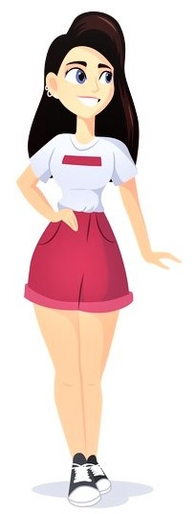
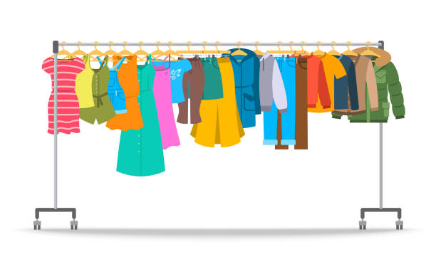
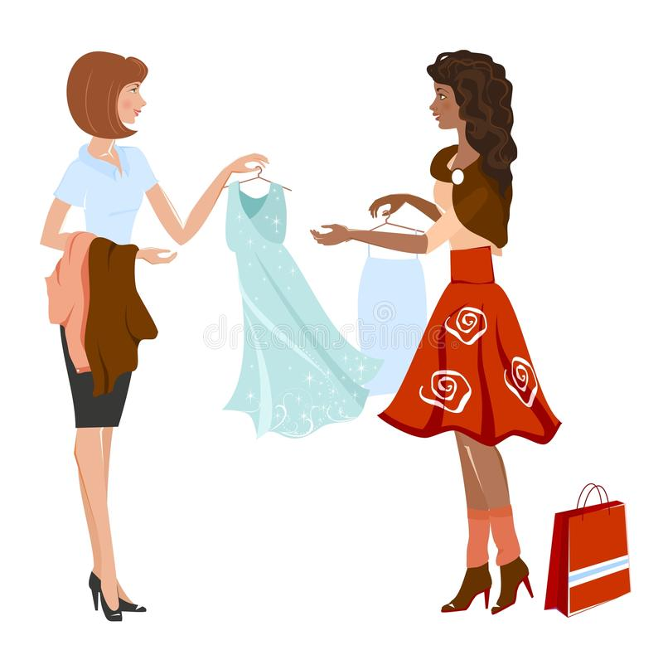
implementation
Web/App based secured GUI
Taking user’s photo from webcam as input
Taking accurate body measurements of user
Output image with the chosen dress
Choosing garment from a cloud database
Size recommendation along with cloth recommendation according
to skin tone

